Slide 1


Leading a Purpose-Driven Organization in a Digital World Order
MIMI BROOKS
LOGICAL DESIGN SOLUTIONS
EPG :: SEPTEMBER 2023

Slide 2

Leading a Purpose-Driven Organization in a Digital World Order
MIMI BROOKS
LOGICAL DESIGN SOLUTIONS
EPG :: SEPTEMBER 2023

Slide 3

To succeed and profit over the long term, organizations need to consider the interests of all their stakeholders – invest in their employees, keep the trust of their customers, partner with their suppliers, and be a good member of their communities – all to ensure that their enterprises flourish far into the future.
THE BUSINESS ROUNDTABLE 2019
Notes:
In 2019, the highly regarded Business Roundtable consisting of 181 prominent business leaders and led by Jamie Dimon, the CEO of one of the largest banks in the world, overturned a decades-old premise of shareholder capitalism by declaring that companies need to consider the interests of all their stakeholders, as well as being a good member of their communities.
Shortly thereafter, the WEF’s Davos Manifesto 2020, entitled ‘The Universal Purpose of a Company in the Fourth Industrial Revolution’, suggested that a company was more than an economic unit generating wealth, as it fulfills human and societal aspirations as part of the broader social system. Performance must be measured not only on the return to shareholders but also on how it achieves its environmental, social, and good governance objectives.”
These declarations represented a sea change from the Milton Friedman credo of business purpose espoused over a half-century earlier when he stated that “The social responsibility of business is to increase its profits.”
It’s difficult to understand these fundamental shifts in investment, policies, and collective action unless we appreciate how people and technology interactions have evolved and are changing the foundational economic, political, and social systems around us. For business leaders, this requires a minimum viable appreciation of specific technologies, their capabilities, and their potential. More important is to connect the dots through an understanding of the relationships between technologies and the systemic changes that they help to catalyze.

Slide 4
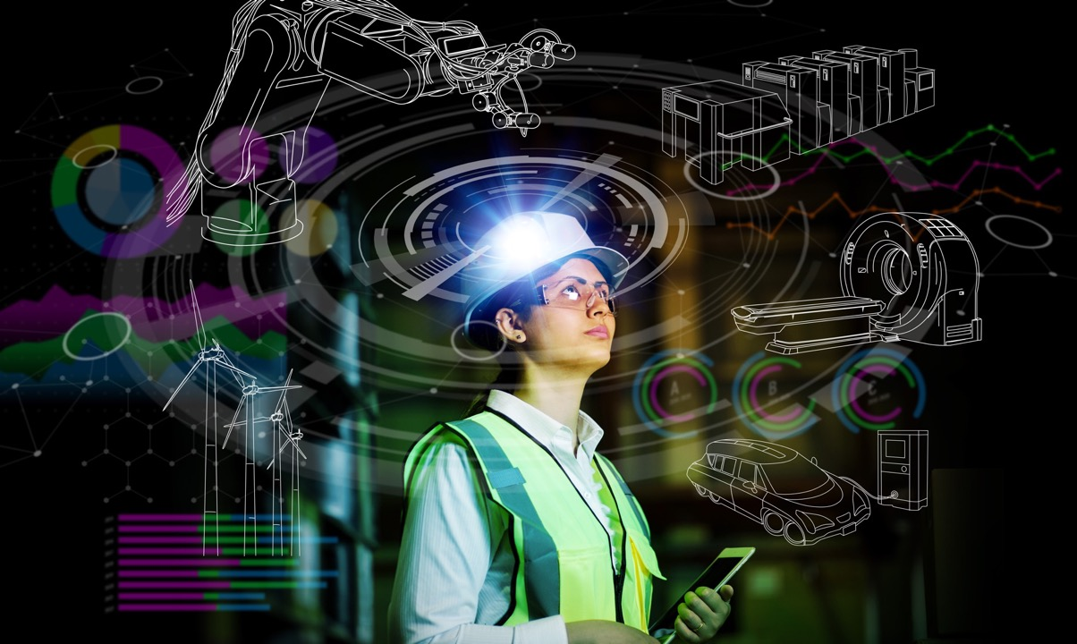
1750-1870
First Industrial Revolution:
Steam and mechanical production
The Fourth Industrial
Revolution defines our moment by the new ways people create value
1871- 1945
Second Industrial Revolution:
Mass production, assembly lines,
electricity
1945-2007
Third Industrial Revolution:
PCs, Internet, IT systems, Computing
2008 - Present
Fourth Industrial Revolution:
Cybertechnology connecting
our biological, physical,
and environmental systems
Notes:
Over the past 250 years, three industrial revolutions have changed the world and transformed the way humans create value. In each, technologies, political systems, and social institutions all co-evolved, changing not just industries, but how people saw themselves, related to one another, and interacted with the natural world. To briefly recap…
Industry 1.0 started in the mid-18th century, sparked by the mechanization of spinning and weaving. Over the subsequent 100 years, it transformed every existing industry and gave birth to many more, from machine tools to steel manufacturing, to the steam engine and railroads. New technologies created entirely new systems of value production, exchange, and distribution, and upended sectors from agriculture to manufacturing, from communications to transport. By 1850, thanks to the impact of these technologies, annual growth rates in the richest countries rose 2-3%, and per capita incomes were rising steadily.

Slide 5

Technological Impact on business, health, and education during the Four Industrial Revolutions
2nd Industrial Revolution
(1871-1945)
3rd Industrial Revolution
(1946-2007)
4th Industrial Revolution
(2008 - Present)
1876 – US Patent for the Telephone
1946 – Launch of ENIAC Electronic Computer
2008 – Monkey controls robot arm with its brain
Electric Lighting Service
Invention of the transistor at Bell Labs
First patent for gene editing
1st Industrial Revolution
(1750-1870)
Marconi’s Radio Waves
First Nuclear Power Station Built
First accident of self-driving car
1843 – The First Typewriter
1882 – Electric Lighting Service
1969 – Apollo 11 lands on the Moon
2023 – GPT-4 Chatbot released
The Spinning Jenny
Launch of the Model T-Ford
Release of the Macintosh PC
1781 – The Steam Engine
First Television Broadcast
1 Billion Mobile Phone Users
1796 – Lithography Invented
1939 – First Jet – Propelled Airplace
2007 – Release of the Apple iPhone
Notes:
The chart shown here draws on data from the UN Human Development Index to show the contribution of different technologies to growth, health, and education outcomes during the industrial revolutions.
As J. Bradford DeLong wrote in Slouching Towards Utopia: "What changed after 1870 was that the most advanced North American economies had invented invention."
In the period between 1870 and 1930, a new wave of interrelated technologies compounded the growth and opportunity that came from the First Industrial Revolution – the radio, telephone, television, home appliances, and electric lighting demonstrated the transformative power of electricity. The internal combustion engine enabled the auto, the airplane, and eventually their ecosystems – including manufacturing jobs and highway infrastructure. There were breakthroughs in chemistry resulting in new materials such as plastics and new processes paved the way for the “green revolution” in agricultural productivity of the 1950s and the subsequent spike in the human population. From water and sanitation to modern healthcare and international air travel, the Second Industrial Revolution ushered in the modern world.
Starting around 1950 and running to the beginning of the new century, revolutionary breakthroughs occurred in information theory and digital computing. The digital revolution started here and brought us general computing, software development, personal computers, and a connected world via widespread digital infrastructure and the internet. As with previous periods, the 3rd Industrial Revolution was not due to the existence of digital technologies, but to the way in which they changed the structure of our economic and social systems. The ability to store, process and transmit information in digital form reformatted almost every industry and dramatically changed the working and social lives of billions of people.
One revolution builds on the next and digital computing capabilities were the general-purpose technology behind the 3IR, thanks to exponential reductions in the size and cost of transistors since their invention in 1947. This provided the essential backbone for Industry 4.0, which started in the early 2000s. At its core is the fusion of powerful, emerging digital technologies and human interaction. Fourth Industrial Revolution technologies share these dynamics:
•They extend and transform digital systems in significant ways.
•They scale exponentially, emerge physically, and embed themselves in people’s lives.
•Their disruptive power is amplified by how they combine and generate new innovations.
•And, they create similar benefits and challenges.
These combinatorial technologies upend existing ways of sensing, calculating, organizing, acting, and delivering. They represent entirely new ways of creating value for organizations and citizens. And they will, over time, transform all the systems we take for granted today.

Slide 6

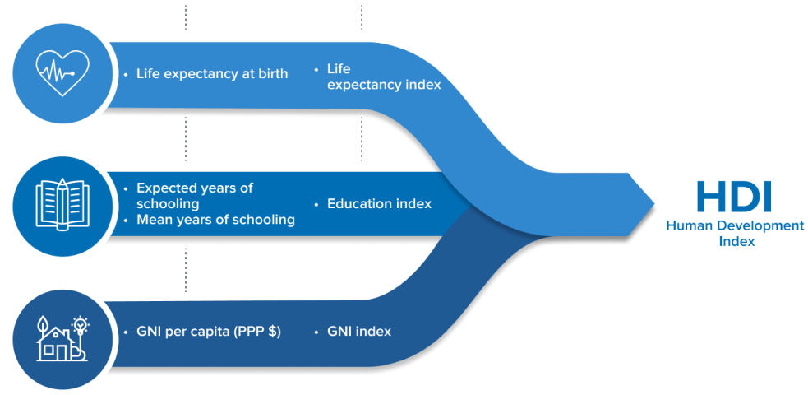
Ensuring the benefits of human development are equitably realized…
DIMENSIONS
INDICATORS
DIMENSION INDEX
Long & healthy life
Knowledge
A decent standard of living
Notes:
First, we must ensure that the benefits of human development are equitably realized.
Less than ten years ago, we began to see a swing towards corporate social responsibility - coupled with Environmental, Social, and Governance ideals.
For example, when it was recognized that climate change could put millions of lives at risk, as well as trillions of dollars of economic activity and physical capital. The 2015 UN Sendai Framework for Disaster Risk Reduction outlined a holistic plan to create more resilient nations and societies, including using digital technology to assist in the restoration of infrastructure and the revitalization of livelihood and industry in the event of a catastrophic event.
When the Business Roundtable CEOs signed their declaration in 2019, they made it clear that companies could not prosper in the long run or adequately reward their shareholders without investing in the stakeholders that make success possible.
Ensuring the benefits of human development are equitably realized is perhaps best illustrated by the UN Human Development Index, which focuses on three major global benchmarks of human existence – knowledge, a decent standard of living, and a long and healthy life. Our challenge is to make this fourth industrial revolution work in a way that fulfills these goals for all of humanity.

Slide 7
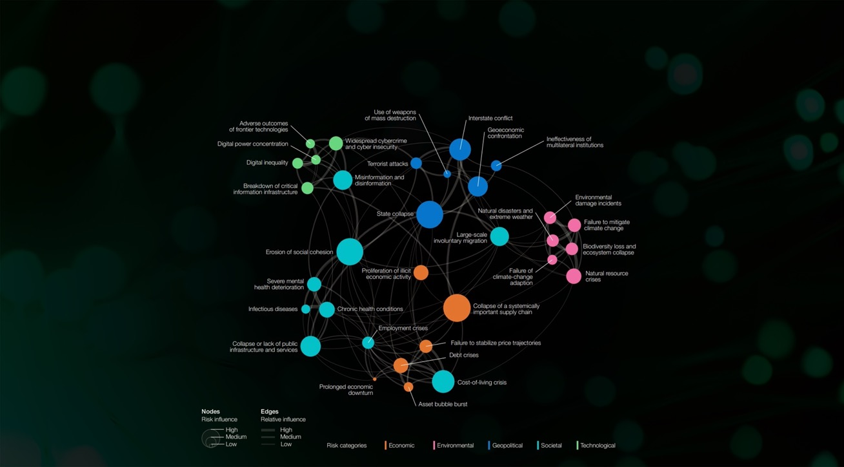
Managing the externalities of 4IR risks and unintended consequences
Notes:
Our second challenge is to manage the externalities of 4IR risks and unintended consequences resulting from both foreseen and unforeseen economic, geopolitical, environmental, social and technological events.
In his 2018 book Shaping the Future of the Fourth Industrial Revolution, WEF Chairman Klaus Schwab writes that “The challenge we face is to come up with new forms of social and employment contracts that suit the changing workforce and the evolving nature of work.” He goes on to write that “The fourth industrial revolution might lead to a dehumanizing dystopia,” while on the other hand, we could use it “to lift humanity into a new collective and moral consciousness based on a shared sense of destiny.”
For example, the Business Roundtable CEOs were concerned that we’ll be never seriously unhappy about the long-term effects of emerging technology, given that private actors will always outperform public ones – what the intellectual Evgeny Morozov would call the market bias - and that adapting to reality beats transforming it – otherwise known as the adaptation bias, and that efficiency will always trump social concerns. This is what Morozov calls the efficiency bias.
Technology as a solution, or what we might call the technological fix, is the idea that all problems can find solutions in better and new technologies. This is now used as a dismissive phrase to describe cheap, quick fixes by using inappropriate technologies – fixes that often create more problems than they solve or give people a sense that they have solved the problem.
All of this implies that at least some of the changing circumstances the World Economic Forum foresees are the results of decisions taken by legislators, regulators, and others in power. One question for all of us to consider is whether we should, as ordinary citizens, engage in and, if necessary, challenge such decisions, rather than simply adapt to whatever the ‘powers that be’ decide the world should be like?

Slide 8

Human-Centricity and The 4IR
Compassion
Imagination
Resilience
Purpose
Intuition
Creativity
Equity
Human
Domain
Wisdom
Understanding
Tacit Knowledge
Machine
Limits
Deeper Knowledge
Logic
Data And Information
Notes:
The third challenge is to ensure the 4IR is human-led and human-centered - ensuring positive human values are incorporated into the technologies changing the world.
Business leaders have a pivotal role to play in developing the mindsets, behaviors, and organizational knowledge that drive human ingenuity, while also cultivating the skills that are needed as the digital workplace evolves.
Companies have long been encouraged to build purpose into what they do. But usually it’s talked about as an add-on—a way to create shared value, improve employee morale and commitment, give back to the community, and help the environment.
So why do companies’ growth strategies rely on building purpose-driven organizations? At its heart, the Fourth Industrial Revolution is about empowering people, rather than the rise of machines. Purpose helps to redefine the playing field, and allows leaders to reshape the company’s value proposition.
The future of work will require a multitude of new human-centric skills, including not just the ability to collaborate virtually in cross-cultural settings, but also to demonstrate both adaptive and computational thinking, as well as assets like social intelligence, a design mindset, sense-making and advanced cognition.
What we are really talking about here is the ability to deal with things like ambiguity – or feeling confident despite not knowing what lies ahead as the second wave of the 4IR unfolds. Workers will need the ability and the passion to learn constantly, to be open to diverse opinions and be willing to compromise, to be able to deliver new value to a fast-moving job marketplace, to be resilient, optimistic and creative.
Human skills must be evaluated based on whether the organization is properly equipped with the talent necessary to realize value creation. If not, the organization must invest in its existing workforce’s skills while also attracting and retaining the most appropriate new talent. While constant learning should be a core organizational expectation of employees, business leaders must also recognize that a strong sense of purpose, a meaningful employee experience, and the key attributes of diversity, equity and inclusion must all be strategic priorities.
Digital age business models must be necessarily purpose-driven and human-centric. While the corporate narrative will unite brand, culture and business strategy into a coherent and powerful story, purpose will clearly define the reason for the company’s existence, the fervor this generates, the need it fulfills, and the new value, social good, and intent that the business is creating for workers, communities, society, and/or the environment.
Digital advances will continue to enable workers to pursue ever more gratifying and purposeful work. Ideally, this work will be aligned not only with the business vision, but also be deeply ingrained with the day-to-day operation and underlying ethic of the entire ecosystem. In this way, the organizational purpose then becomes the driver of digital transformation, rather than the converse.

Slide 9

The Leadership Mindset
  Systems, not
  technologies
  Empowering, not determining
  By design, not
  by default
  Values, not disengagement
Notes:
In order to survive and flourish over the coming years, leaders will need an agile mindset in order to systematically innovate, so that their organizations can harness the full potential of the digital infrastructures evolving around them.
Rather than relying on a rigid hierarchical chain of command, we must embrace an intrapreneurial decision-making process that relies on advice from those who possess expertise relevant to the problem being solved – such as a centralized sustainability team – coupled with input from those who must live with the consequences of any decision made.
Today, we face the task of understanding and governing 21st-century technologies with a 20th-century mindset and 19th-century institutions. Business leaders must adapt to the 21st-century challenges we face.
Four important principles to keep in mind when thinking about how to define a leadership mindset in the purpose-driven organization are:
Values, not disengagement;
Empowering, not determining;
Systems, not technologies and
By design, not by default.
Let’s look at each of these in more detail.

Slide 10


  Systems, not
  technologies
  Empowering, not determining
  By design, not
  by default
  Values, not disengagement
The Leadership Mindset
Systems, not technologies
Notes:
​
​
Systems, not technologies​​
​
The conundrum here is whether we will be able to truly understand how technologies are transforming the systems we need to run our business without attempting to gain a deep understanding of the different technologies themselves? At the very least, we need a minimum viable understanding of emerging technologies. We also need to explore trends and linkages across these technologies to understand how they relate to one another and will cumulatively impact our organizational systems.​
​
​
​

Slide 11

Systems, not technologies
Empowering, not determining
Notes:
​
​
Empowering, not determining ​
​
We must design systems that harness new technologies to give our workers more autonomy and control over their everyday tasks. Shaping the Fourth Industrial Revolution to ensure that it is empowering and human-centered, rather than divisive and dehumanizing, is not a facile task. By empowering subordinates, leaders are also more likely to be trusted and be more effective at influencing performance. ​
​
​
​
​

Slide 12

Empowering, not determining
By design, not by default
Notes:
​
​By design, not by default​​
​
Culture exists in an organization either by design or by default, so why not design it intentionally based on how we want our organization to work? The challenge here is for leaders to create a culture that encourages workers to focus on what is essential. Thinking like a startup, putting purpose first, creating a mutual understanding of the company's mission and vision, living your company values, and even thinking critically about an employee’s first day in the company are all part of the leadership mindset. ​

Slide 13



Values, not disengagement
Notes:
VALUES, NOT DISENGAGEMENT
All technologies implicitly have values baked into them, from the initial idea to how they are developed and deployed. We must recognize this and debate values at all stages of technological innovation. Today, we can argue that sources of employee disengagement attributed to technology today might include perceived threats to job security, obsolescence, invasions of privacy, data integrity, and misinterpretation of data collected.
A recent analysis conducted by McKinsey found that recent advances in AI will cause significant disruption in jobs held by higher wage knowledge workers, whose roles were previously thought to be immune to technological change, while a CNBC survey conducted in June of this year reported that a quarter of all workers are worried that AI will make their jobs obsolete.
We also know that data privacy varies greatly from country to country. In the US, data privacy decisions typically reside with the individual. In Europe, the government has taken greater steps to regulate data. Although technology can offer a great many potential contributions in the workplace, for people to feel comfortable with privacy, the integrity of the data and the data collection process itself must be safeguarded beyond reproach. Misuse, or the perception of misuse, of the data continually collected from employees could quickly erode trust in leadership and the organization. Also, misinterpretation of data leads to less than helpful recommendations for employees and consequently lower user adoption. At worst, it could create greater levels of disengagement and eroded trust.
In contrast, a leadership mindset focuses on value creation as a motivating activity that results in change and transformation within the workplace and which gives employees new avenues for career advancement. The World Economic Forum ranks analytical thinking as the most important source of value creation, followed by creative thinking, ahead of three self-efficacy skills – resilience, flexibility, and agility; motivation and self-awareness; and curiosity and lifelong learning. Dependability and attention to detail, ranks seventh, behind technological literacy. The core skills are completed by two attitudes relating to working with others – empathy and active listening and leadership and social influence – as well as quality control. All of these skills have one thing in common – the crucial ability to create new value in the digital age.
Of course, the organizational components of profit-making—things like revenues, cash, gross margin, cost structure, and funding—are the same as ever. But the emphasis, the patterns, the timing, and the relationships among them are different. Using these differences to create value for the employee, consumer, and shareholder at the same time is a new kind of business savvy and a source of competitive advantage.
Here are eight diverse ways to create new value in today’s organization…

Slide 14

Creating New Value
Universal Value Creation
Value-Creating Ecosystem
Continuous Learning
Innovation at
the Edges
Expanded Trust Boundaries
Drive Towards the Common Good
Redesign for Speed
Diversification
Resource Allocation
Notes:
All technologies implicitly have values baked into them, from the initial idea to how they are developed and deployed. We must recognize this and debate values at all stages of technological innovation. Today, we can argue that sources of employee disengagement attributed to technology today might include perceived threats to job security, obsolescence, invasions of privacy, data integrity, and misinterpretation of data collected.

Slide 15

With technological change accelerating, purpose-driven companies recognize the need to make some fundamental changes.
Creating New Value
Innovation at the Edges
Product
Paradigm
Shifting Innovation To The Edges
Position
Process
1
Innovation must develop around personal networks of experts and autonomous teams at the edges of the organization and be supported by capabilities that scale the benefits across the business.
Notes:
First, In the digital age, competitive advantage goes to those who build an ecosystem, or network, on the edges of the organization that leverages digital technology for the benefit of the consumer and paves the way to multiple streams of revenue.
What’s different among digital giants is that their ecosystems are not just linear—that is, aligned with a company’s vertical supply chain—they are exponential and multi-dimensional. These new-generation ecosystems might encompass a vast range of partners across multiple sectors. Innovation must develop around personal networks of experts and autonomous teams at the edges of the organization and be supported by capabilities that scale the benefits across the business. Edges are powerful sources of business innovation because they are places of potential and friction, where traditional products and practices are no longer adequate to address unmet needs or unexploited potential.
A fundamental prerequisite of a strategic shift to the edges is indicative of a much more horizontal focus on deeply understanding customer behaviors and expectations, and rapidly adapting to those expectations as they change. Offering the customer something innovative, faster, or more efficient is key. This means using advanced technologies to retrieve insights from customer data, and the ability to transcend silos and sectors.

Slide 16


New value creation is made possible by the ingenuity of workers, aligned in clear purpose and equipped with technological insights.
Creating New Value
Continuous Learning
Risk-Taking Culture
Blameless Reflection​
Lightening Talks
Personal Objectives
Interest Groups
Lunch & Learns
Creating A Culture Of Continuous Learning
2
Training Programs
Coaching
Technological literacy is becoming core to every worker’s role in creating new value, requiring learning to be continuous and built at the level of individual skills that are deployed at the point of need.
Notes:
Second, as the futurist Heather McGowan says, employers will no longer hire for skills, which will constantly be evolving, but instead, they will hire people for their ability to learn. Where technical skills once were most in demand, human skills — things like flexibility, adaptability, time management, and prioritization are moving to the top of the value-added chain. Those who thrive in the future will be those with the ability to learn, unlearn, and adapt.
This will create huge opportunities for those companies that develop true 4IR-oriented intelligence through a continuous-learning culture.

Slide 17
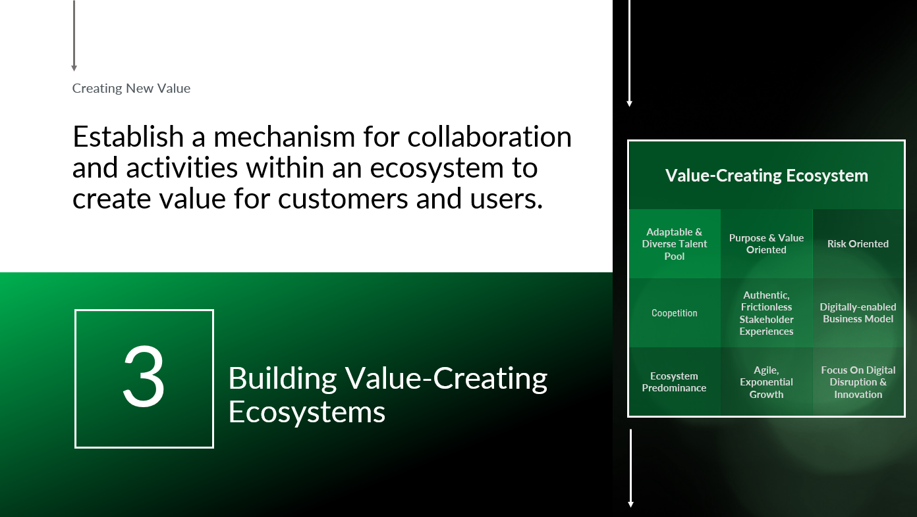
Notes:
Third, In the digital age, competitive advantage goes to those who build an ecosystem, or network, that leverages digital technology for the benefit of the consumer and paves the way to multiple streams of revenue. ​
​
What’s different among digital giants like Microsoft and Alibaba is that their ecosystems are not just linear—that is, aligned with a company’s supply chain—they are exponential and multi-dimensional. These new-generation ecosystems encompass a vast range of partners across multiple sectors. ​
​
A fundamental prerequisite of a strategic shift from what we will call a ‘vertical mindset’ to that of an ‘ecosystem mindset’ is indicative of a much more horizontal focus on deeply understanding customer behaviors and expectations, and rapidly adapting to those expectations as they change. Offering the customer something better, faster, or more efficient is key. This means using advanced technologies to retrieve insights from customer data, and the ability to transcend silos and sectors because customers are now utterly agnostic about brands. ​
​

Slide 18

The expanding digital landscape means that companies must broaden their trust capabilities around security, privacy, and cyber.
Creating New Value
Expanded Trust Boundaries
ETHICAL
EXPLAINABLE
Inclusiveness
Fairness
Transparency
Expanding Trust Boundaries
4
Belonging
Privacy & Security
Reliability & Safety
Trust must cover a greater array of stakeholder concerns and become an enterprise-wide responsibility that opens doors to unimpaired value creation.
Notes:
Fourth, the expanding digital landscape means that a steady undercurrent of privacy and trust concerns around ever-more-sophisticated conveniences is raising the stakes on the broad topic of trust.
For example, users are becoming more aware of their identity rights, making decisions based on values, and demanding the ethical use of data and responsible use of AI.
We need to consider putting trust management at the core of both our employee experience, as well as business processes. Workers are hungry for social cohesion and purpose. They want to feel that their contributions are recognized and that their team is truly collaborative. They desire clear responsibilities and opportunities to learn and grow. They expect their personal sense of purpose to align with that of their organization. And they want an appropriate physical and digital environment that gives them the flexibility to achieve that elusive work–life balance.

Slide 19

Developing governance structures that are not purely centered around shareholder value but around a true common good.
Creating New Value
Drive Towards the
Common Good
DRIVERS
OUTCOMES
Openness
Connectivity
Inclusiveness
Driving Towards The Common Good
5
Cooperation
The goal of creating universal value means that the public sector, local communities, philanthropy, labor, and others should all be part of, and benefit from, business decisions.
Notes:
Fifth, we must drive toward the common good.
To rethink the role that business should play in society, companies and governments need to radically reconsider how value is created in our capitalist economies: who creates it, who extracts it, and what happens when extraction is rewarded over creation. A true commitment to stakeholder value requires more than words, gestures, or speeches of goodwill. It requires purpose to be put at the center of how value is defined in firms and in governments.
In the context of the current challenges we face, such as the climate and the cost-of-living crises, challenges are more complex — they require not just technological change but also social, regulatory, and behavioral shifts. These problems are socio-economic in nature, raising questions about social justice, economic security, and political stability. To successfully cooperate across regions and industries, decentralized governance structures within the projects themselves can incentivize bottom-up innovation.

Slide 20

Business leaders must be bold to further increase the speed of decision making and execution.
Creating New Value
Redesign for Speed
PROCESS REDESIGN
DIGITIZATION
INTELLIGENT PROCESS AUTOMATION
Streamline Processes and Minimize Waste
Digitize Customer Experience and Day-to-day Operations​
Introduce Intelligent Automation to Replace Human Tasks​
6
Redesigning For Speed
ADVANCED ANALYTICS
Provide Intelligence​ to Facilitate Decisions​
Starting points - Enhance the operating model, Identify bottlenecks, Actively monitor potential risks.
Notes:
Sixth, leaders today are redesigning their organizations for speed, accelerating productivity improvements, reshaping their portfolio and innovating new business models, and reallocating constrained resources. Organizational silos, unclear strategies, and slow processes frequently interfere with attempts to make decisions and get work done more quickly.
Our starting points must include identifying the bottlenecks, enhancing the operating model, and actively monitoring potential risks.

Slide 21

Business leaders must be bold to further increase the speed of decision making and execution.
Creating New Value
Value-Creating Ecosystem
OPERATIONS
Identity
Growth
Bust Organization Silos​
Purposeful Enterprise​
Accelerate Organization Learning​
Turbocharge Decision Making​
Distinctive Culture
Adopt Ecosystem Perspective​
7
Diversifying
Attract Scarce Talent​
Sharp Value Agenda​
Build ​Data-Rich Platforms​
Starting point - diversifying business units operating in design and delivery, data and analytics, utilization management, and other technology and service arenas.
Notes:
Seventh, although disruptors may have speed, incumbents have their own natural advantages. These include existing relationships and the trust of clients and members, the ability to quickly scale up what works across markets, time-honed operational discipline at scale, and, in some cases, opportunities for diversified growth to strengthen the core business as well.
Across sectors, business building by adopting a diversified mindset is a top priority for value creation.

Slide 22

Across economic contexts, companies that actively reallocate resources outperform those that don’t.
Creating New Value
Resource Allocation
Determine Resource Demand​
Conduct Rules-Based Project Prioritization​
Understand Resource Limitations​
Conduct Strategic Assessment​
Track Performance Effectively​
Allocate Resources & Update Plans​
8
Reallocating Resources
Identify Resource Needs & Strategic ​
Starting points - maintain clarity on the objectives for capital allocation, take a dynamic approach to budgeting, and align talent to value.
Notes:
Lastly, in challenging times, the reallocation of resources is more important than ever. Many organizations struggle to reallocate at the necessary pace. Successful reallocators follow a tested portfolio of processes that aim to seed high-growth areas with the resources necessary to succeed while avoiding retrenchment in the core business.

Slide 23

Empowering, not determining
Notes:
EMPOWERING, NOT DETERMINING
New forms of institutional innovation will pave the way for a new leadership mindset that heralds unprecedented change and guides the workforce towards opportunities to flourish even as technological advances drive seismic shifts across all organizations. At its heart, this movement is about empowering people, rather than the rise of machines.
This second focal point of the leadership mindset involves giving workers more autonomy and control over their everyday tasks to ensure that work is empowering and human-centered, rather than divisive and dehumanizing. By empowering subordinates, leaders are also more likely to be trusted and be more effective at influencing performance. Rather than a focus on determining outcomes in an era of unprecedented technological evolution, business leaders must seek to implement systems that give workers more choice, opportunities, freedom and control over their lives. This is key when we consider the ways in which emerging technologies increasingly harness machines that can decide and act without human input.
As the philosopher John Armstrong points out "When we look at the past, we can see many, many world-changing things were possible at the time, which people did not realize. We know this. What we forget to tell ourselves is that this must be true for us in the present as well.“

Slide 24

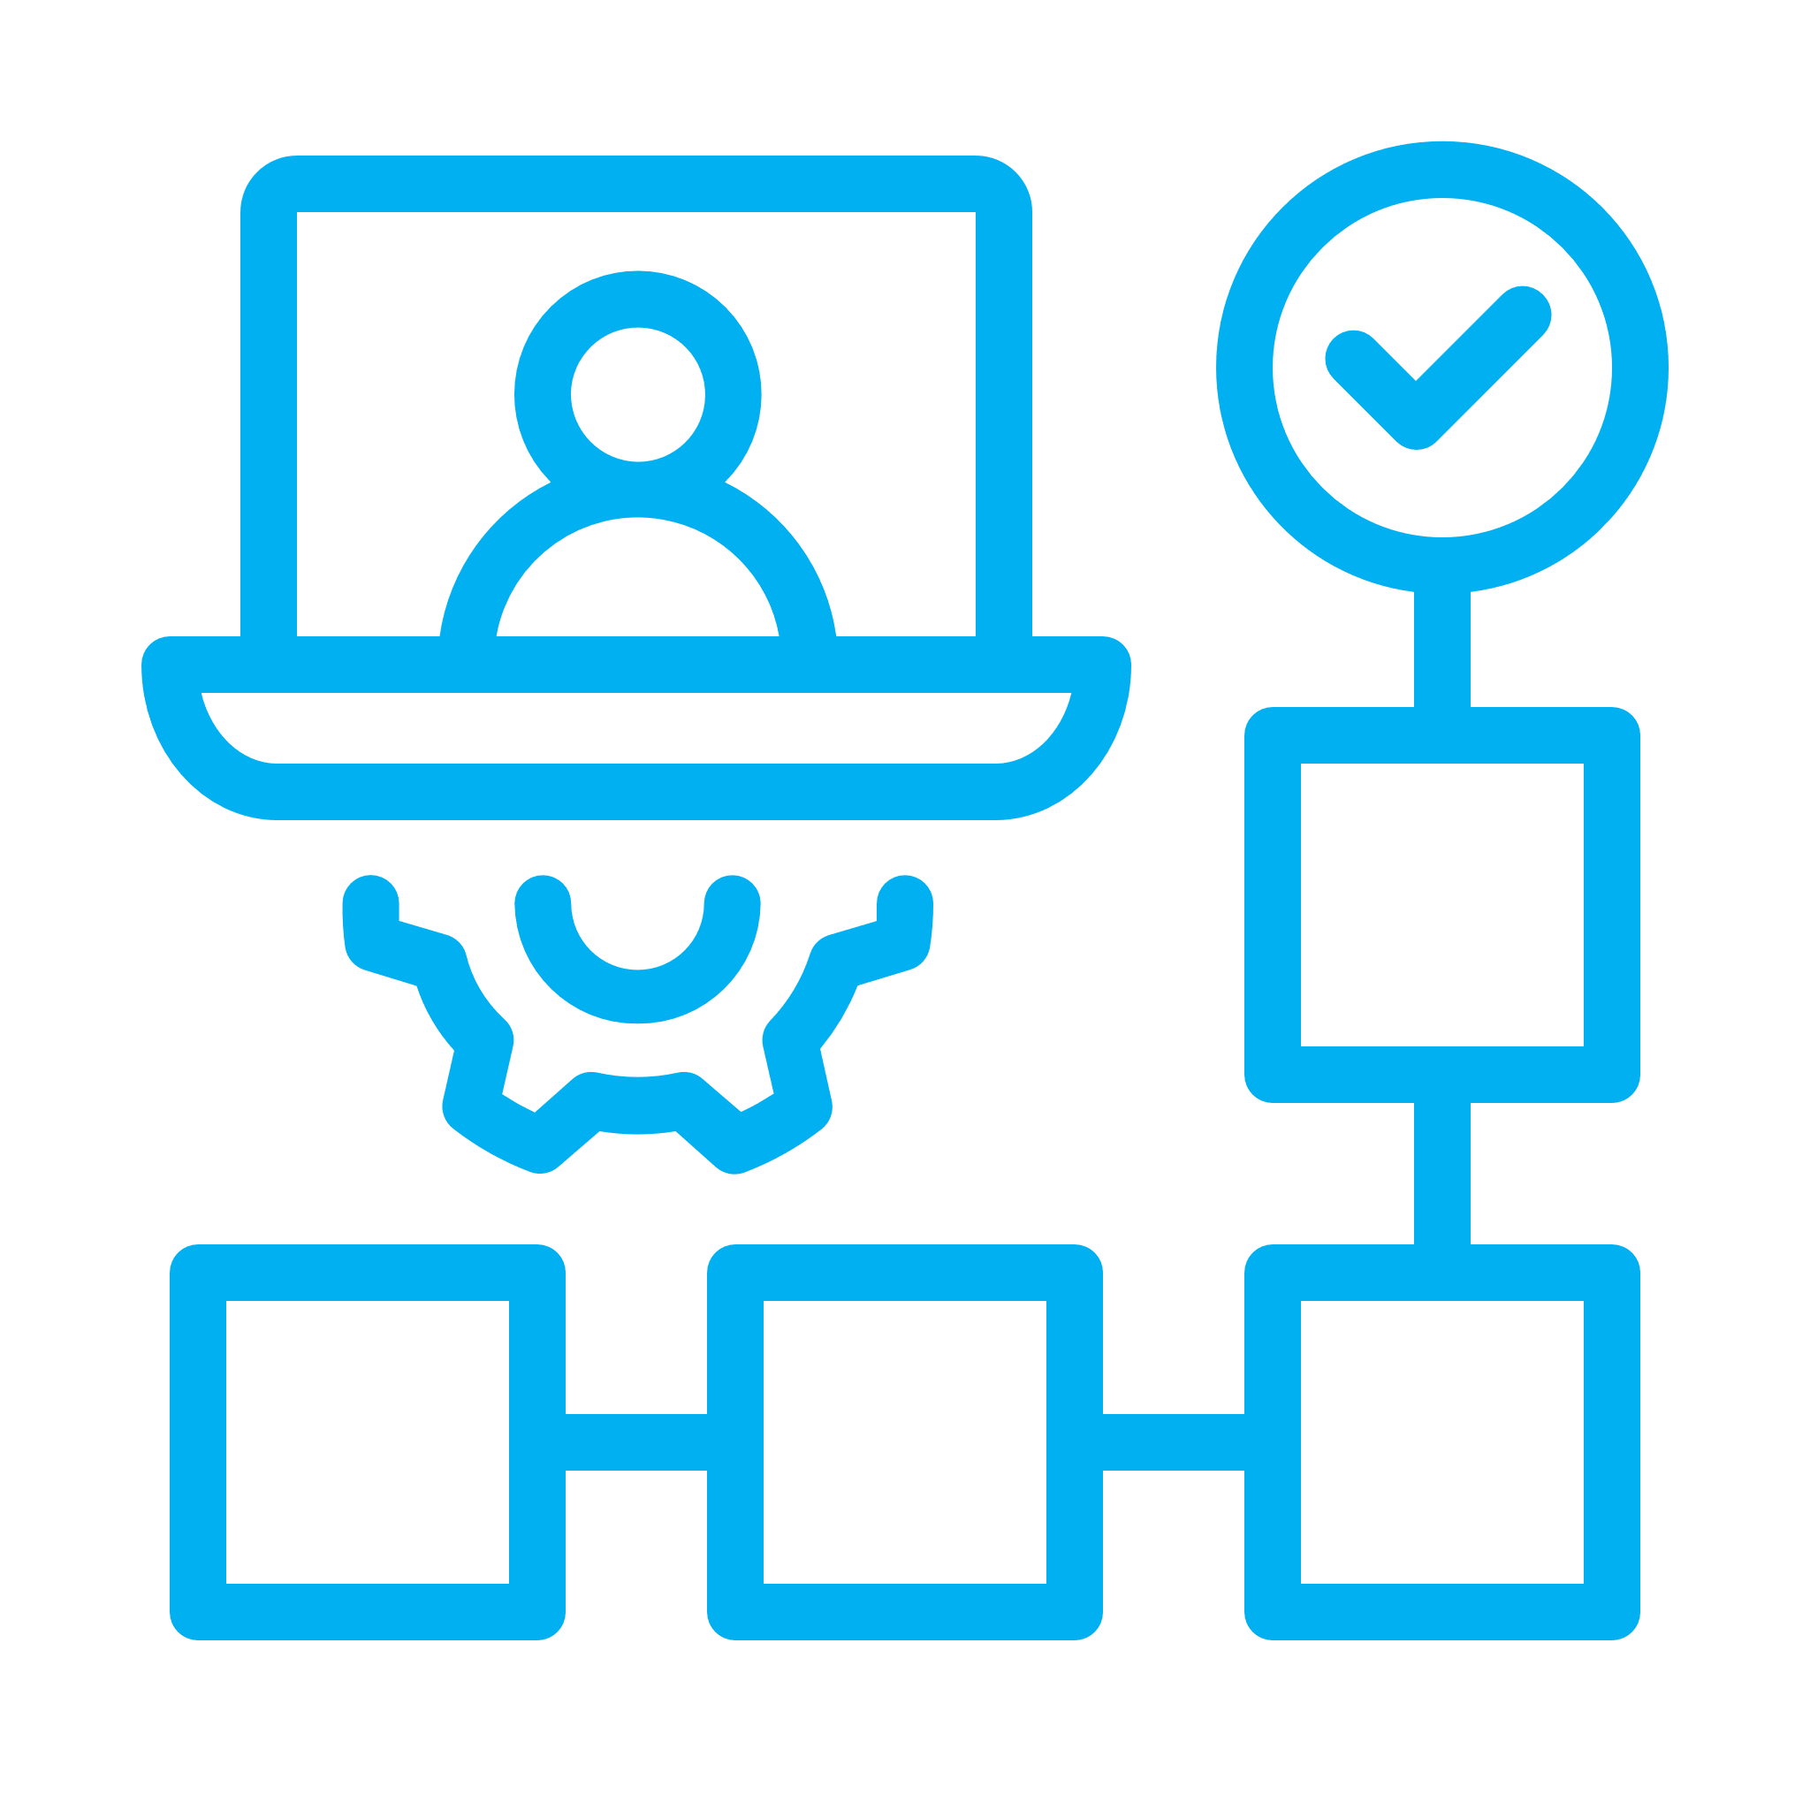
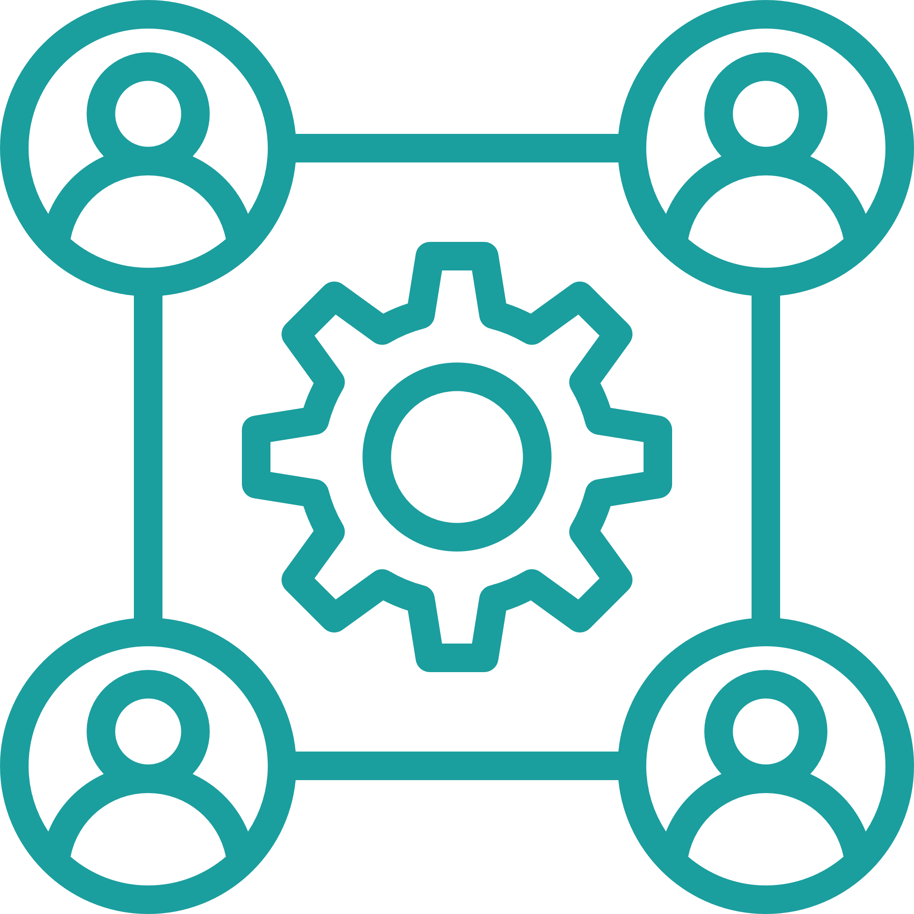

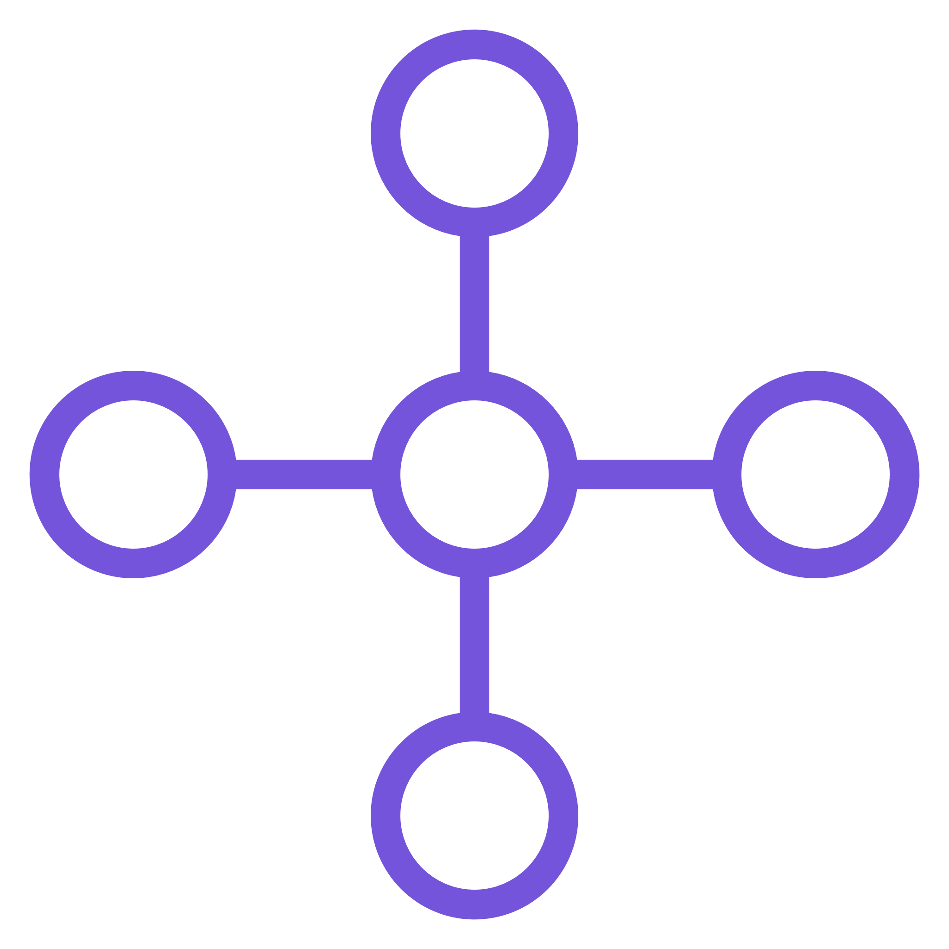
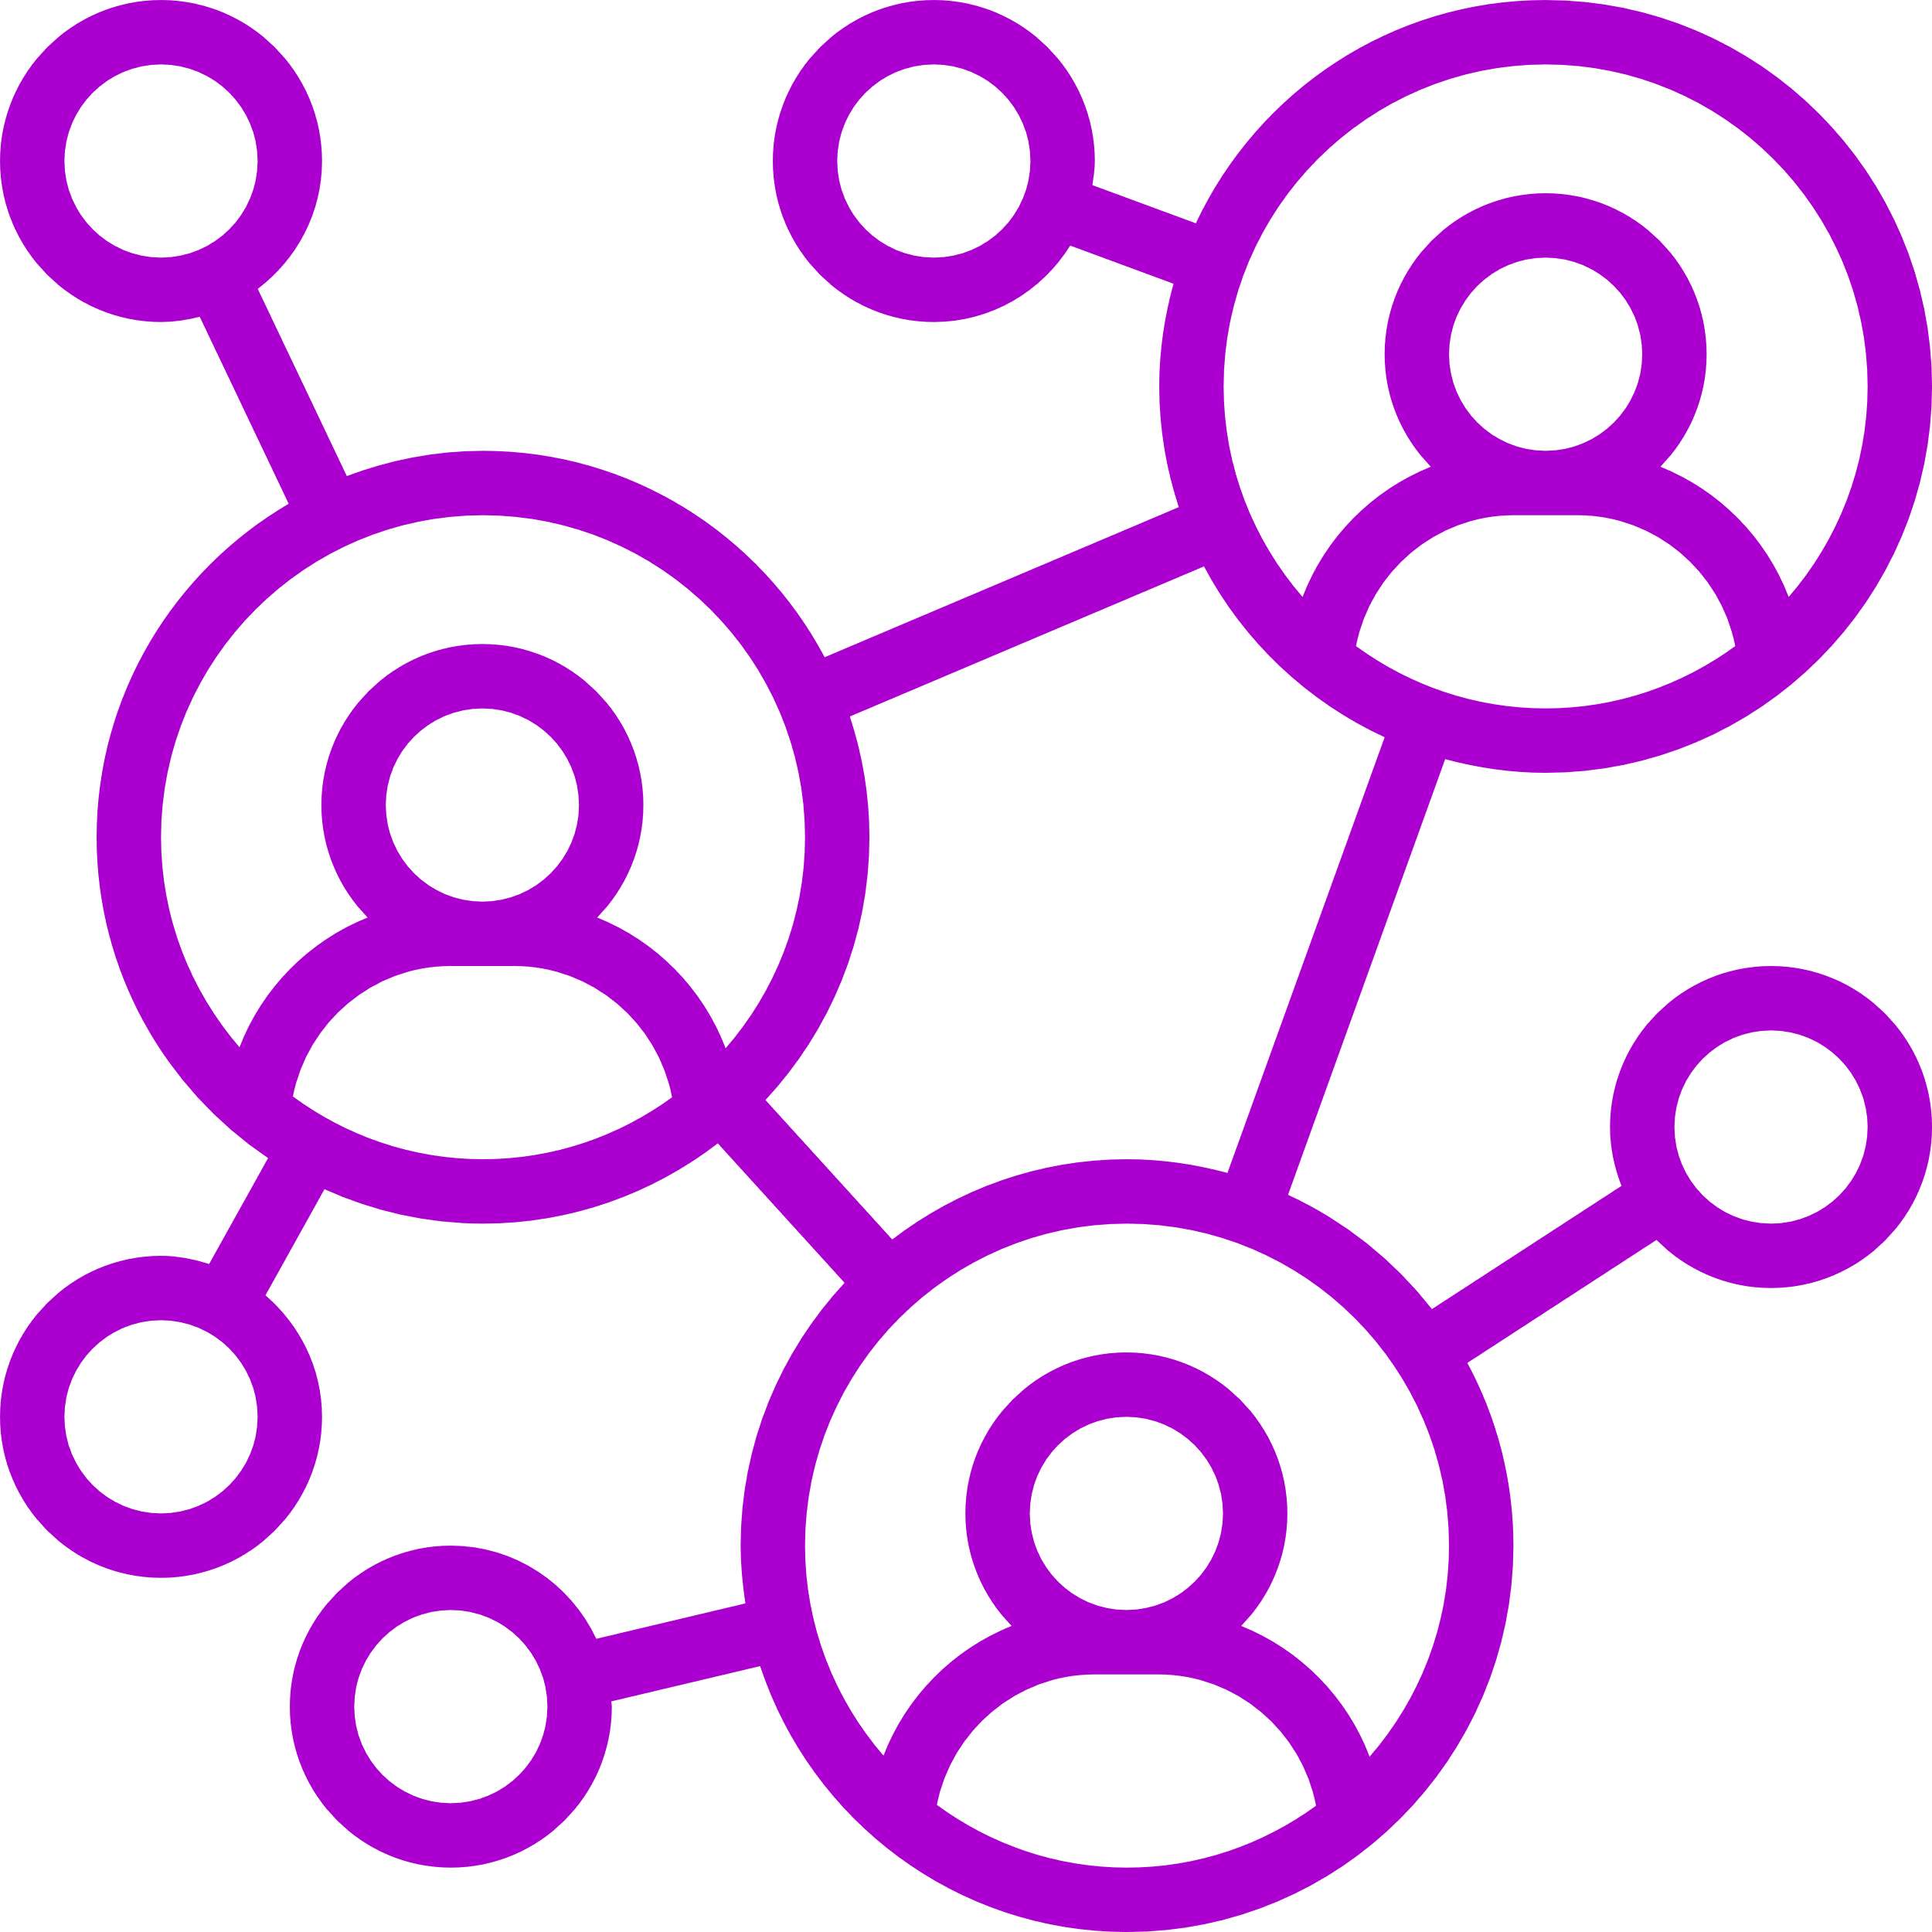




Connected Enterprise vs. Organizational Silos
Value Stream
Management Platforms​
Standardized
Processes
Collaboration Tools​
Central Hubs​
Advanced
Communication Platforms​
Network
of Teams
Flexible
Resources
Holistic Operating Systems​
Connected Organization
The company as an organism
Intelligent Data Management​
Notes:
For example, organizational silos are one of the most disempowering challenges that every purpose-driven organization faces today, leading to conflicting or misaligned priorities, lack of clarity, and fragmented approach to execution.
Siloed approaches affect the connected enterprise in multiple ways. First, they lead to increased technology complexity due to fragmentation, resulting in diverse architectures, systems, and processes across teams. This complexity hinders the seamless integration of new technologies, innovation, and responsiveness to customer needs. Additionally, siloed decisions and development can lead to incompatible technological solutions, interoperability issues, and increased technical debt. These challenges increase the pressure for short-term workarounds, further escalating technical debt and complexity impacts.
Organizations must rethink and integrate traditional organizational silos that separate administration from the front lines, that is, create multiple knowledge pathways that lead to bidirectional work practices and innovation. This is merely the initial foray into empowering the entire workforce to transition from traditional, hierarchical models to decentralized, multi-dimensional knowledge networks.
In a stark contrast, today’s employees and workers are empowered in ways never before seen in traditional organizations, and managerial determination is diminishing. Today, we are experiencing a paradigm shift that is changing the way we work and relate to one another, as the digital age rewards change and punishes inertia. We are moving away from the concept of the organization as a machine which is designed to predict and control the world, and into the sphere of collective intelligence and knowledge informed by a living organism that has its own sense of destiny in an increasingly short-lived and chaotic business environment.
The vitality of an organization will be measured by its capacity to dynamically adapt its business, empower its workers, and grow sustainably through holistic operating systems, value stream management platforms, centralized hubs, collaboration tools, advanced communication platforms, and intelligent data management. The idea that a leader’s job is to extract value from processes and people is morphing into a strategic focus on adaptability and learning that exemplifies the connected organization through networks of teams, flexible resources, and standardized processes. This is where progressive and alternative points of view bring cognitive diversity to the organization and increase its ability to rapidly respond to new opportunities.

Slide 25




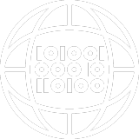

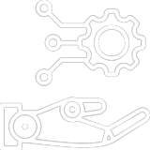

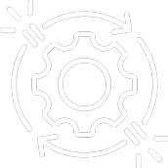
The Connected Enterprise – Six Points of View
Empathetic Management
Digital Dexterity
Data Collection
Smarter Machines
Purposeful Work
Remote Challenges
Notes:
Current trends in business and technology show that the way employees work - where, when, why and with whom - have and will continue to change over the next decade, bearing little resemblance to work as it stands today. Here are six ideas about the future direction of the workplace and how organizations can prepare for it.
Managers today must confront remote challenges, such as social and political turbulence, work-life fusion and hybrid work – all of which have added a new layer of complexity and pressure to their roles.
Many employees are working in a hybrid world with more choices about where, when and how much they work. Traditional managerial success was based on the ability to manage and evaluate employee performance. This has shifted. Managers are now expected to be great coaches and teachers, and operate with empathy.
In the future, the most high-value work will be cognitive in nature. Employees will have to apply creativity, critical thinking and constant digital upskilling to solve complex problems. The digital economy demands new ideas, information and business models that continually expand, combine and shift into new ventures. Employees will have to consistently refresh their digital dexterity to meet these needs. Extreme digital dexterity will ultimately be the modus operandi for how employees work. Increasing demands for a more automated workplace have sparked the killer combo of people and technology. Proactive leaders must investigate how the regular use of AI, smart software and robots will invigorate work strategy.
Remote and hybrid work has fostered greater interest in monitoring workplace productivity and employee wellness. Today, employers are more frequently using technologies to monitor employees through methods such as virtual clocking in and out, tracking work computer usage, and monitoring employee emails or internal communications and chat. While some companies primarily track productivity, others focus on collecting data around employee engagement and well being to better understand the employee experience.
Smart machines are getting smarter and more ubiquitous, not only completing tasks previously reserved for humans, but also doing what was thought to be impossible for machines. Companies will start to increase the functions of smart machines, software, apps, and even avatars.
As the metaverse begins to take shape, employees will develop personal toolkits of virtual doppelgangers - virtual counterparts, with the help artificially intelligent software and devices that are more accessible to their personal or team-based activities. What’s more, they will have the ability to carry their personal workplaces with them using cloud communities, open applications and personal virtual assistants.
Employees want to make a meaningful social impact and they will do this earlier in their lives instead of waiting for retirement. People will actively seek purposeful opportunities to tie the impact and value of their work to their mission and passions. Smart companies will make themselves more attractive, not solely by paying higher salaries, but also by offering employees an opportunity to make a meaningful impact. Build a message that resonates and drives engagement by creating initiatives for employees to come forward with personal stories, experiences and successes in various social causes.
As technology closes the divide between geographically separate people, it introduces cracks in relationships and cultures. The remote distribution of work means that many employees will not build the same social relationships in the workplace, leading to issues of disengagement and loneliness.
Business leaders must work together to ensure work-life balance swings back and forth for each employee as their work distribution, time and life stages change.

Slide 26

Systems, not technologies
Defining Human-Machine Interactions
Activating Ecosystems via Platforms
Directing Technological Influx
Notes:
SYSTEMS, NOT TECHNOLOGIES
Our third facet of the leadership mindset asks whether we will be able to truly understand how technologies are transforming the systems we need to run our business without attempting to gain a deep understanding of the different technologies themselves? At the very least, we need a minimum viable understanding of emerging technologies. We also need to explore trends and linkages across these technologies to understand how they relate to one another and will cumulatively impact our organizational systems.
If we as business leaders zoom out – as John Hagel, the former leader of the Deloitte Center for the Edge, suggests – we find ourselves asking questions like, ‘What will my relevant market look like in a decade from now? What kind of systems will I need to have in order to thrive in that market or arena?’ Only then can we consider the technologies that may support those systems.
At the same time, we must zoom in to identify two or three short-term projects that will have the greatest impact in accelerating the organization’s movement toward the longer-term opportunities already identified. These would be accompanied by considerations of technological implementation, resource allocation, and relative measures of success in attaining the desired end state.
When we connect the dots between these two approaches, we see that emerging technologies must rely upon and extend digital systems, scale readily due to a foundation of digital interoperability, inhabit physical objects, combine in surprising and disruptive ways, and create similar benefits and challenges.
Fourth Industrial Revolution technologies promise to disrupt even today’s systems and create entirely new sources of value, turning the breakthroughs in digital technologies that organizations are struggling to make sense of today into the core infrastructure that business models will take for granted tomorrow. New technologies can enable better-performing systems to be put in place; without them, new technologies could even be detrimental to existing systems.
There are three key areas of focus when we talk about systems, not technologies. These are activating ecosystems via platforms, directing technological influx, and the evolution of human-machine interactions. Let’s look at each of these in a little more detail.

Slide 27



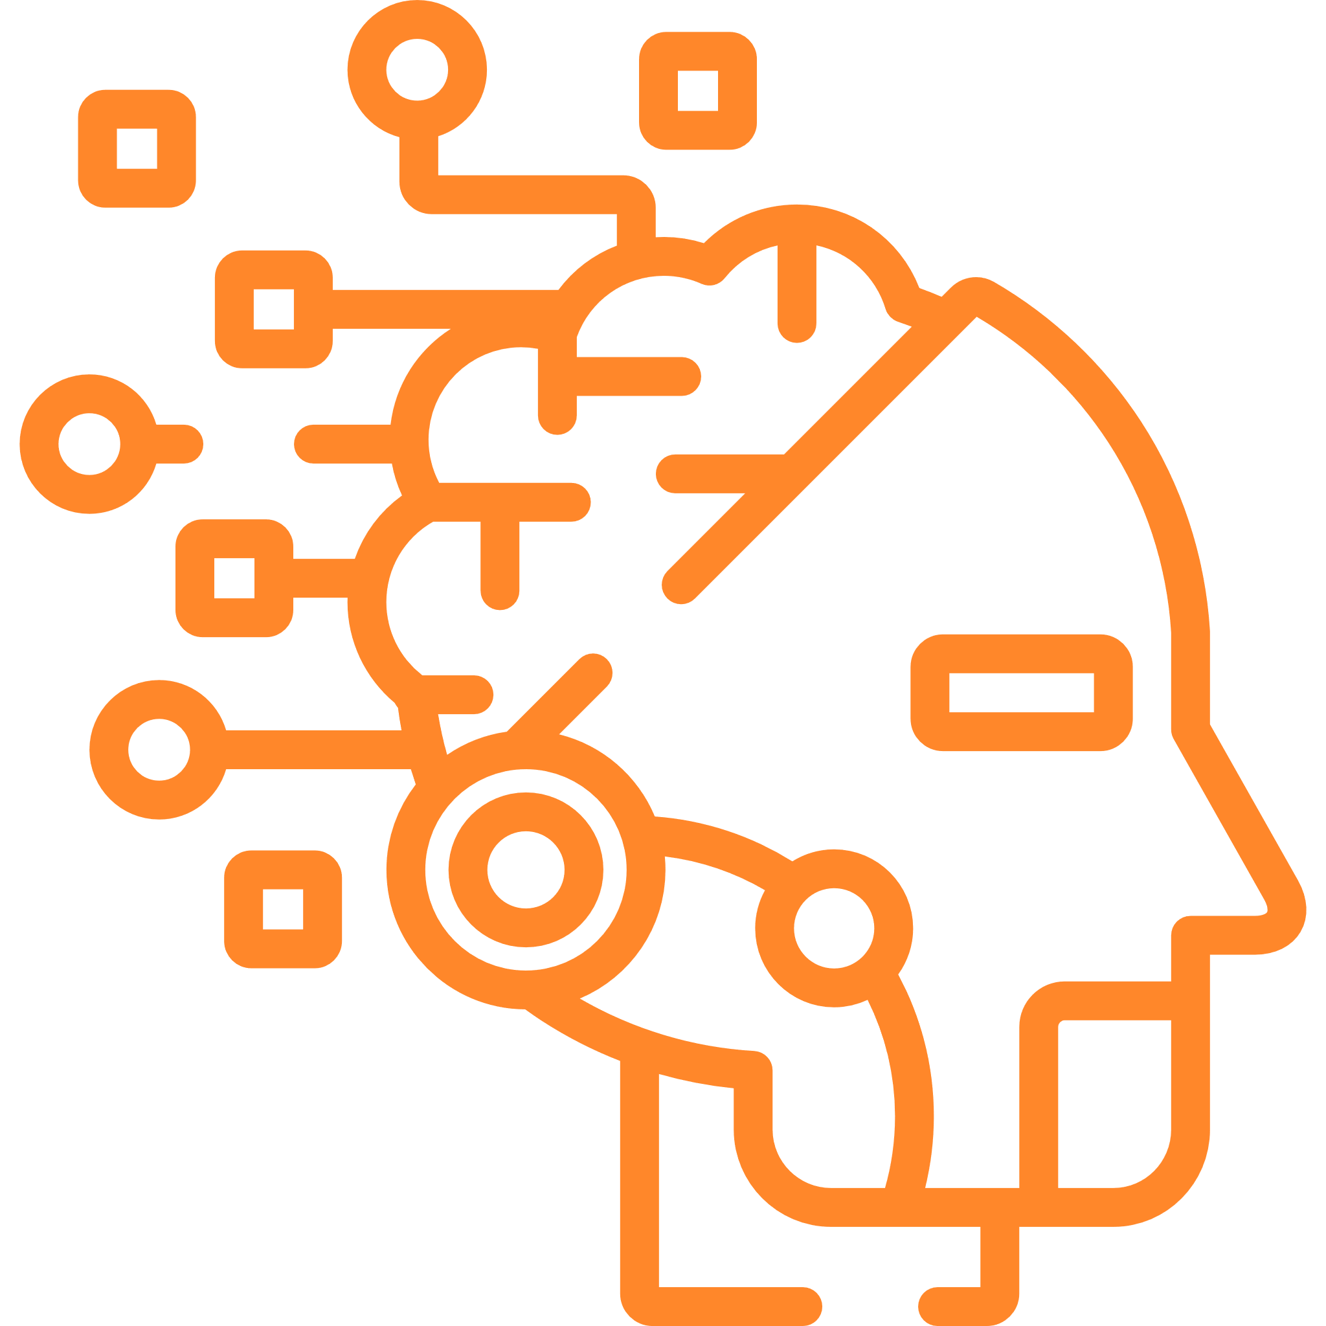

The Evolution of Human-Machine Interactions
Massive amounts of
data & storage
Machine Learning Algorithms
Faster and more reliable communications
Exponential increases in computing power
Cloud storage / smart devices, social media platforms, and the
Internet of Things (IoT)
Neural networks, image and speech recognition, natural language processing.
5G bandwidth, Blockchain
Edge Computing, reduced latency and enhanced data privacy
2.5 quintillion bytes
Replace 85M jobs
20 gigabits per second
500 billion pages
Notes:
Third – the evolution of human-machine interactions
Currently, there are four key developments that are directly impacting the efficacy of human-machine interactions. These are the ability to store massive amounts of data, the emergence of increasingly powerful machine learning algorithms, the deployment of faster and more reliable communication systems, and exponential increases in computing power.
Massive amounts of data and storage, also known as Big Data, is a combination of structured, semi-structured and unstructured data collected by organizations that can be mined for information and used in machine learning projects, predictive modelling and other advanced analytics applications.
Machine learning algorithms detect patterns and learn how to make predictions and recommendations by processing data and experiences, rather than by receiving explicit programming instruction. The algorithms also adapt in response to new data & experiences to improve efficacy over time. The World Economic Forum have predicted that this application of AI will replace 85 million routine jobs by 2025.
We are also benefitting from faster and more reliable communications, such as 5G with its increased bandwidth, and areas like blockchain development that increase the veracity of our transactions.
Exponential increases in computing power are also contributing to the evolution of human-machine interactions. Consider, as a recent example, that GPT-4 uses a data source of one Petabyte – that’s an extremely large unit of digital data, one Petabyte is equal to 1,000 Terabytes. Some estimates hold that a Petabyte is the equivalent of 20 million tall filing cabinets or 500 billion pages of standard printed text.
For many organizations, the amount of fully automated work will be small compared to the amount of work expected to be performed in a hybrid partnership. As humans increasingly take their hands off and on the wheel at work and rely on machines to do as much as possible, this area will be a critical focus for both organization and work design. We are quite unprepared for this challenge, with issues ranging from ethical design to social and economic policies to ready leadership and an equipped workforce.
The extraordinary and unprecedented rise of the creator economy is a prime example of systematic ingenuity…

Slide 28

Prime Example - Generative AI and the Future of Work
How Artificial Intelligence will reshape the workplace and the employee experience
Strategic Work
Global
Knowledge
Pursuing New Markets
Enhancing Services
Information Collection
Designing EX experiences
Research
AI-enabled Knowledge Worker
Using Unique Knowledge
Enterprise
Knowledge
Generative Insights
Communicate & Collaborate
Automation
Decision-making
Innovation
Decisions
Tactical Work
Safety
Optimizing Operations
Global
Knowledge
Ethics
Business Administration
Gathering Information
Compliance
Notes:
Generative AI has the power to revolutionize and expand what some are calling the creator economy. Already, brands and creators are experimenting with GPT-4, DALL-E 2, and other models to develop creative briefs, text, video thumbnails, and images. Social platforms and creator economy start-ups are rolling out generative AI tools but due to major limitations, generative AI won't replace creators.
Generative AI will serve as a creative spark for sponsored content and spur new growth in the creator economy. The biggest impacts on this segment will be in expediting the content creation process, facilitating brand-creator sponsorships, driving investment growth, and acting as the catalyst for more creative tools from social platforms.
The current capabilities available through generative AI will allow users to generate text, develop creative briefs, produce audio, and pitch brands. However, due to the limitations of emerging technology, generative AI is unable to generate original ideas, produce complex videos, and streamline the process of creator identification.
Many brands and agencies are already using AI to measure and optimize influencer marketing campaigns. But generative AI is a whole new ballgame that every business needs to prepare for now.

Slide 29

The Age of AI
1980s
Machine
Learning
2020s
2040s
2060s
Deep Learning
Narrow AI
General AI
Super AI
Machine Learning
Deep Learning
Full Cognitive Capabilities / Human Mimicry
Well Beyond Human Cognitive Capabilities
Supervised, Unsupervised, Reinforcement
Recognition of Complex Patterns
Notes:
In their 2022 book entitled The Age of AI, Henry Kissinger, Eric Schmidt, and Daniel Huttenlocher declared that AI is “the partial end of the postulated superiority of human reason”.
Although AI is progressing far less predictably than Moore’s Law, the authors believe that it will progress at least as fast as computing power, yielding a millionfold increase in fifteen to twenty years, allowing the creation of neural networks that, in scale, are equal to the human brain.
In a word of warning, Kissinger writes that “while the number of individuals capable of creating AI is growing, the ranks of those contemplating this technology’s implications for humanity – social, legal, philosophical, spiritual, moral – remain dangerously thin.”
Along the same lines, in May of this year, more than 350 technology executives, researchers, and academics signed a statement warning of the existential dangers of artificial intelligence., saying that “Mitigating the risk of extinction from AI should be a global priority alongside other societal-scale risks such as pandemics and nuclear war.”
The bottom line in all of this is a call for responsible development and governance of the technology, education, and awareness-raising efforts, international collaboration and cooperation, aligning AI with human values, containing AI with proper safety measures, ensuring transparency and oversight of AI development, and encouraging responsible use and behavior by users.

Slide 30


Explainable AI – Taking the Genie out of the Bottle
Explainable AI is an area getting a lot of attention in the business environment today.
From this
Input
Output
Black Box
I understand why
I understand why not
I know when you succeed
I know when you fail
I know when to trust you
I know why you erred
To this
Input
Training Data
New Machine Learning Process
Explainable Model
Explanation Interface
Notes:
As most of you are already fully aware, it’s crucial that we never lose sight of the fact that every AI application uses rules, data, and inferences that are often derived from inputs originally sourced from human beings. As a consequence, bias, stereotypes, and other influences are all in play, so we sometimes need a way to understand how and why certain conclusions are reached by the system. Accurate and understandable explanations are a key challenge as these systems evolve to deeper learning and complex neural network algorithms​​
​
As Artificial Intelligence becomes more and more pervasive in the business decision-making process, it is crucial that both users and those impacted by the outcome can understand exactly why and how the AI model is generating its responses. This is why visual or plain language explanation around the logic of its Machine Learning method is of paramount importance.​​
​
Explainable artificial intelligence will allow humans to better understand - and trust - outputs from complex, “black-box” models and helps decision-makers know the relevant features ​or data characteristics driving the output.​​
​
​

Slide 31



Solutionism or Humanism?
Technology as a Solution
Technology as an Assistant
Notes:
Before moving on, I would like to present a somewhat contrarian view that I think you will find thought-provoking.​​
​
In July of this year, the New York Times published an article by the intellectual Eygeny Morozov entitled ‘The True Threat of Artificial Intelligence.’​​
​
Morozov argues that technology and its acceptance as a panacea for all problems – what he calls solutionism - is inhibiting our ability as humans to creatively and imaginatively problem-solve. ​​
​
According to Morozov, solutionism doesn’t really solve problems; it simply monetizes the behavioral change of an individual. Organizations are actually under-producing solutions because the sort of structural solutions that are not favorable to capital never come into existence. This ultimately goes back to the idea that the only thing that matters to organizations is shareholder value.​​
​
In other words, the only way to decrease risk is to take the time to think ahead about things that might go wrong – but this is not something that technology advocates are necessarily taught to do. As Morozov puts it: ​​
​
“Solutionism presumes rather than investigates the problems that it is trying to solve, reaching for the answer before the questions have been fully asked. How problems are composed matters every bit as much as how problems are.”​​​
​
​

Slide 32

By design, not by default
PLANET
PROSPERITY
Risk Factors
Sustainability
New Rules
PURPOSE
Common Good
Equity Inclusion
PEOPLE
Ethics & Technology
Notes:
By design, not by default
In order to succeed in the new world order, we must never resign ourselves to the inevitability of default options. In practical terms, design thinking - particularly employing the techniques and philosophy of human-centered design - as well as systems thinking approaches, can help us to understand the structures that guide the world and appreciate how new technologies may shift systems into new configurations. Design thinking has a human-centered core. It encourages business leaders to focus on the people they're creating for, which in turn leads to better products, services, and processes.
The Futurist Gerd Leonhardt declares that 'science fiction is becoming science fact' and since humans are biological and don’t progress exponentially, we often have a very hard time understanding where our new technologies are going. What may be really amazing, magical, and “good” for us today, may soon become “too much of a good thing”, and go from being a tool to being the purpose, from being a god-send to being a doomsday machine!
Today we have a profound opportunity to reimagine ways of working, as well as the norms of human interest and interaction that help create a cohesive culture, generate social solidarity, strengthen purpose, boost resilience, and build shared trust and cooperation.
The World Economic Forum has attempted to put it all into perspective, stating that:
“A company is more than an economic unit generating wealth. It fulfills human and societal aspirations as part of the broader social system. Performance must be measured not only on the return to shareholders, but also on how it achieves its environmental, social, and good governance objectives.”
Culture exists in an organization either by design or by default. As business leaders we must create a culture that encourages workers to focus on what is essential, putting purpose first, creating a mutual understanding of the company's mission and vision for both mutual prosperity and the common good of all, and living your company values of equity and inclusion. Purpose, prosperity, people and planet…

Slide 33





Purpose
Governance
Culture
Individual Purpose
Human Work Purpose
Purpose
Organizational Purpose​
Business Purpose begins with intentions but is revealed through how the company operates and the decisions it makes.
Intent
Notes:
As Mark Twain famously wrote, “The two most important days in your life are the day you are born and the day you find out why.”
A clear business purpose provides the foundation for institutional value. ‘Purpose’ is stated as an intention, but it is evidenced through the actions, decisions, and rewards that become culture.
Purpose and culture are also the starting point for all transformational Employee Experiences. A truly purpose-driven approach facilitates growth in new ecosystems, it suggests that companies should broaden their mission, create a holistic value proposition, and deliver lifetime benefits to customers.
There are three key areas allied to the purpose-driven organization. These are intent, culture, and governance:
Intent
For example, has the company set out an authentic, practical, and inspiring purpose that will benefit all stakeholders? The true purpose is rooted in the belief that success and well-being are interdependent and cannot be maximized in isolation. This means believing that for the company to maximize shareholder returns over the long-term, it must pursue strategies that create societal benefit, and the value it creates is applied in everything the organization does, not just when it is convenient.
Culture
Designing a purpose-driven organizational culture based on well-being and flexibility, as well as worker growth and safety, is key to solving one of the biggest challenges today. That is for business leaders to cultivate a working environment that safeguards the mental health and physical, emotional, and economic well-being of workers, as well as the more complex considerations that drive employee satisfaction and engagement levels. Internal influencers in this regard include relationships with co-workers, tools and resources, flexible hours of work, remuneration, and workplace safety. These attributes are all key to promoting a robust and attractive company culture.
Governance
Does the way the business is governed and operated reflect its purpose? The organization’s leaders embody the purpose and are authentic in their desire for the company to live by this credo. This needs to be reflected in everything from the way Board meetings are conducted to the way in which new talent is recruited.
The notion of leading with purpose provides the north star to organizational transformation by creating a relationship between individual purpose, the changing nature and purpose of human work, and organizational purpose. Leading with purpose from a business perspective means influencing, inspiring, and guiding the workforce with clarity, focus, and the confidence to act regardless of circumstance.
I believe it’s critical that we also have a clear understanding of what value creation means. For today’s value-minded executives, creating value cannot be limited to simply maximizing today’s share price. Rather, the evidence points to a better objective: maximizing a company’s value to its shareholders, now and in the future.

Slide 34

Prosperity
Create the future of
work experience
Leverage Algorithms, Information & Data as essential worker tools
New Rules of Competition
Personalize the customer experience
Compete via business-digital ecosystems
Build horizontal capabilities and alliances
Align people, culture, and work design as the new social engine
Notes:
We live in a new world with new rules of competition. If we look at companies that are digital giants today, what do they do? They imagine a marketplace one hundred times greater than the one that exists today. They utilize digital platforms at their core and build systems that accelerate growth. Their money-making is tied to exponential development, and their business leaders drive learning and reinvention.
I believe there are several new rules of competition designed to ensure prosperity in the digital era:. If you’ll bear with me briefly, I shall go through these, as they are particularly relevant today:
•Leveraging algorithms, information, and data as essential tools - this involves learning on fast-acting computerized timescales, which leverages these assets in combination with slower-acting human learning to create a scalable organizational model that reorganizes tasks and roles to maximize the productivity of humans and machines working together.
•Competing via business-digital ecosystems – this means designing business-digital ecosystems that emanate from a digital workplace whose core attributes include content management, targeting and variability, intelligent dashboards, attention management, experience content, and sophisticated search capabilities.
•Aligning people, culture, and new work design as the new “social engine” – in other words using people, culture, new ways of working, and new work design to form a powerful social engine. By this we mean that work is redesigned to maximize technology by eliminating routine tasks, using algorithms to automate decisions, and providing metrics and learnings to guide decision-making.
•Building horizontal capabilities and alliances – these must align with organizational strategy, purpose, and values. Here, we are looking at a future of work experience by building a digital workplace platform that reinforces a culture of inclusion and inspires innovation. The building blocks of this experience include transformational and purpose-driven initiatives, such as peer-to-peer marketplaces, the engagement of leaders as coaches and advocates, and the adoption of common work practices.
•Personalizing the customer experience - opportunities in the digital age are vastly bigger than at any previous time in business history. Leaders are keeping a laser focus on the individual customer in everything they do. The customer drives every decision that they make. They develop a concrete vision of the consumer experience they want to create and the specific reasons why the customer will prefer it.
•Creating the future of work experience - centers on the creation of a future of work experience that accelerates transformation for workers through an operating model that is fundamentally driven by business purpose, culture, and growth mindsets. This embraces both employee and worker experiences through approaches in cross-disciplinary teaming and personalization, situational awareness, and new management approaches driven by hybrid working environments.
In concert, these new rules of competition form the nucleus of realizing prosperity by accelerating human performance and advancing human capability in the digital economy.

Slide 35

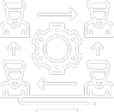
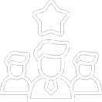
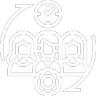

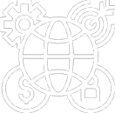
People
Adaptive Workers
Proficient Leaders
Flexible
Teams
Agile Organizations
Dynamic Business Ecosystems
Notes:
Henrick von Scheel, the Industry 4.0 originator, once said that "People are the centerpiece of the Fourth Industrial Revolution."
While much is being touted today about advances in big data, artificial intelligence, cloud computing, augmented reality, and autonomous systems, the 4IR is fundamentally about empowering people and the acceleration of organizational performance. It is as much about advancing human capability as it is about the rise of machine intelligence. Indeed, we live in an era where the pace of change is so fast that workers must constantly adjust to their environment using skills that were largely not needed by employers during earlier industrial revolutions.
Gender, ethnic, and cultural diversity and inclusion, particularly within executive teams, continue to be correlated to financial performance across multiple countries worldwide. What drives this correlation is that more diverse companies are better able to innovate, attract top talent, improve their customer orientation, enhance employee satisfaction, and secure licenses to operate.
Also, building human capital to secure a motivated, productive, and skilled workforce is a key priority for companies. When firms fail to invest in training, education, skilling, and reskilling of their employees, it can affect their business performance, reputation, and ability to attract a talented workforce. It can also lead to higher operating costs related to recruiting, developing, and retaining employees.
Using people, culture, new ways of working, and new work design to form a powerful social engine, means that work is redesigned to maximize technology by eliminating routine tasks, using algorithms to automate decisions, and providing metrics and learnings to guide decision-making. Through culture and awareness of environmental, social, and governmental prerogatives, a company can drive continuous innovation, superior customer service, human-centered design, and business models that are in sync with ESG priorities. Putting the right people in place means combining highly diverse values, behaviors, talents, and skills.
By putting people, culture, and new work design at the center of our dynamic business models while removing bureaucratic layers that block the free flow of ideas, we tap into the universal human endeavor to be dissatisfied with the status quo and to creatively search for what’s next.

Slide 36

Planet
Take Responsibility
Live
With Virtue
Eudaimonia
Focus On What
You Can Control
Notes:
As Winston Churchill once proclaimed: “You can always count on Americans to do the right thing – after they've tried everything else,” and I would respectfully adapt this quote to transpose “humans” for “Americans”
There will inevitably be things that should never be tried because they may have irreversible and existential consequences for humans and our planet. Starting with the pursuit of artificial general intelligence, geo-engineering, and human genome editing – all of these technologies could potentially be good for our planet – or the opposite. And who will be "mission control" for humanity?
It may be as well for us all to remember that around 2,500 years ago, the Greek philosopher Aristotle defined what he called eudaimonia - the highest human good. A commitment to happiness, health, and prosperity for all. Eudaimonia has stood the test of time for several reasons.
In today’s vernacular, value creation is a key purpose of an experience that helps us align to this ideal of eudaimonia by developing agility, embracing adaptation, and learning with good intent.
Unlocking innovation and value for the good of our planet will be driven by multidimensional systematic thinking that views the business environment as a complex network in which everything is interconnected. As we begin to assume more imaginative roles, creating value through interrelationships will become a key part of our existence. Humans will seek to distinguish themselves from increasingly powerful and adaptive technologies by adding new dimensions of creative thinking and problem-solving.
According to one prominent business leader: “If we help each other apply and strengthen our skills, learn new things, engage in meaningful relationships, build emotional strength, maintain physical health, and connect with something larger than ourselves, then our planet will flourish – and so will we.”

Slide 37

Leading a Purpose-driven Organization
in a Digital World Order
Values, not disengagement
The Leadership Mindset
Empowering, not determining
By design, not by default
“
Today we have a profound opportunity to reimagine ways of working, as well as the norms of human interest and interaction that help create a cohesive culture, generate social solidarity, strengthen purpose, boost resilience, and build shared trust and cooperation.
Systems, not technologies
”
Notes:
In conclusion, and as Martin Reeves and Jack Fuller wrote in their book The Imagination Machine, “To imagine and realize new ways to meet collective and individual needs, companies must tap into the full humanity of the people who work for them – the reward of which is sustained growth.”
So, if we consider our definition of Artificial Intelligence, for example, as being computer systems that turn data and information into knowledge – then what is our part as humans in all of this?
The fact is that AI does not discriminate in terms of what it considers knowledge. For example, generative AI tools have no judgment, no values, no consciousness, and no sense of wrong or right. Basically, these are just a massive conglomeration of zeroes and ones – a computer system that turns data and information into content, rather than knowledge.
The bottom line? To really move into the realm of competitive supremacy, we need to not only leverage ground-breaking technologies but also be able to achieve something purposeful in everyday business that a machine cannot emulate, as well as keeping our focus on the future of the workforce - or as the American chocolate maker and philanthropist Milton S. Hershey put it bluntly more than a century ago when he said that “business is a matter of human service.”
The successful organization of the future will seek to instill a purposeful value delivery system into everyday commerce by targeting not only frontier technologies, but also the exclusively human competencies the organization most desires, whether these are allied to productivity, profitability, or the realm of innovation.
As the futurist Alvin Toffler once wrote, “The illiterate of the 21st century will not be those who cannot read and write, but those who cannot learn, unlearn, and relearn.”

